Slide 1


CamRadar
Limitations
Database
Features
System Function
Introduction
Future Scope
Haarcascade
Conclusion
Application
Libraries Used
Problem Definition
Developed by:
Agent Mir Pasad
Agent Soham Dave
Agent Param Rawal
Guided by:
Miss Prachi Arora

Slide 2

Computer Vision
Limitations
Introduction
Database
Features
System Function
Haarcascade
Future Scope
Conclusion
Application
Libraries Used
Problem Definition
Computer Vision is mimicking the abilities of human vision by electronically perceiving and understanding an image

Slide 3
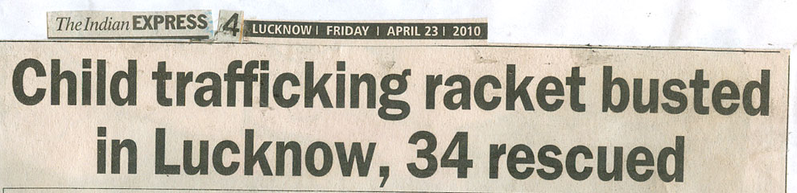
India has a high volume of Child trafficking.
Rise in Rape Cases
Illegal rescue of criminals
Real Time Problem: A person was rewarded 1 crore INR because he was sentenced for 3 years even though he was not a criminal. The reason was the actual criminal was his identical brother (twin)
Limitations
Introduction
Database
Features
Future Scope
System Function
Haarcascade
Application
Conclusion
Libraries Used
Problem Definition

Slide 4
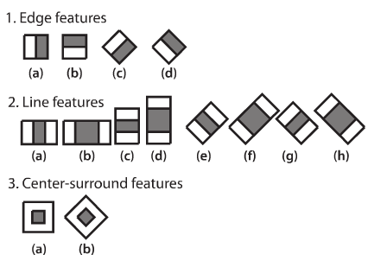
All human faces share some similar properties.
These regularities may be matched using Haar Features.
Haarcascade
Limitations
Introduction
Database
Features
System Function
Future Scope
Conclusion
Application
Libraries Used
Problem Definition

Slide 5
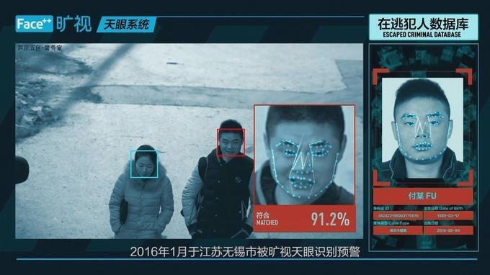
Security provided by CamRadar
Notifying authorities on detection of a criminal anywhere anytime
Haarcascade
Limitations
Introduction
Database
Features
System Function
Application
Future Scope
Conclusion
Libraries Used
Problem Definition

Slide 6


Open CV
Open CV (Open source computer vision) is a library of programming functions mainly aimed at real-time computer vision
Libraries Used
Haarcascade
Limitations
Introduction
Database
Features
System Function
Application
Future Scope
Conclusion
Problem Definition
NumPy
NumPy is a general purpose array-processing package

Slide 7
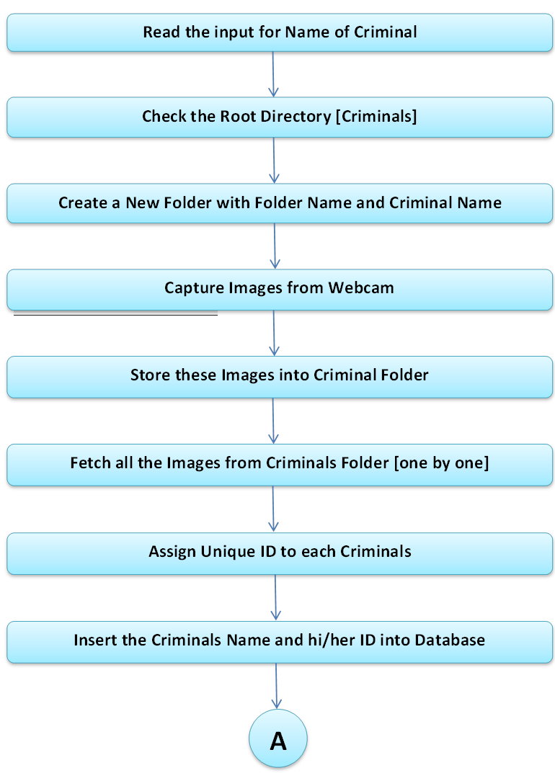
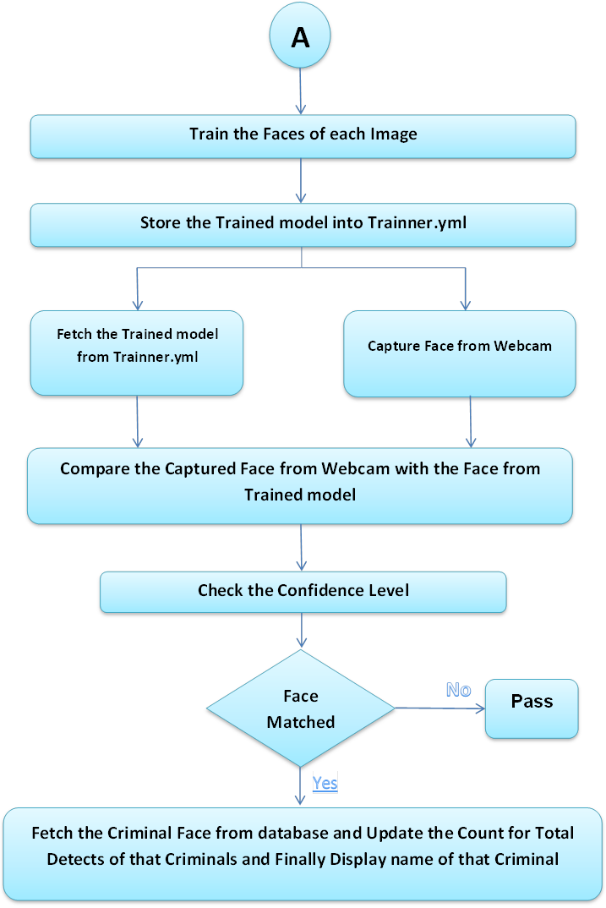
Trainer
Detector
Libraries Used
Haarcascade
Limitations
Introduction
Database
Features
System Function
Future Scope
Application
Conclusion
Problem Definition

Slide 8
Libraries Used
Haarcascade
Limitations
Introduction
Database
Features
System Function
Future Scope
Application
Conclusion
Problem Definition

Slide 9
Trainer
Detector
Libraries Used
Haarcascade
Limitations
Introduction
Database
Features
System Function
Future Scope
Application
Conclusion
Problem Definition

Slide 10
Libraries Used
Haarcascade
Limitations
Introduction
Database
Features
System Function
Future Scope
Application
Conclusion
Problem Definition

Slide 11
Trainer
Detector
Libraries Used
Haarcascade
Limitations
Introduction
Database
Features
System Function
Future Scope
Application
Conclusion
Problem Definition

Slide 12
Lighting:
The lightning conditions may differ during the course of the day
Position:
Position in the image of the object can be changed
Mirroring:
The mirrored image of any object must be recognized by the object recognition
System
Occlusion:
The condition when object in an image is not completely visible is referred as
occlusion.
Misclassification can occur if multiple targets are close together.
Limitations
Libraries Used
Haarcascade
Database
Introduction
Features
System Function
Future Scope
Application
Conclusion
Problem Definition

Slide 13
Face recognition has its applicability in various ﬁelds. On the basis of results obtained in our analysis, the future scope can be stated as:
Room for improving accuracy: The accuracy for multiclass classiﬁer can be improved . Various other techniques can be implemented and compared to obtain better accuracy results for a large database.
On getting a better accuracy we can use it in diﬀerent ﬁelds for the purpose of security.
We can also add features of weapon detection or sentimental analysis for further crime prevention.
Limitations
Future Scope
Libraries Used
Haarcascade
Database
Introduction
Features
System Function
Conclusion
Application
Problem Definition

Slide 14



Its 2019 and data analysis and data research is an essential part of every system.
Our state of art system has integrated python data with MySQL for database management and we have used PHP for frontend data analysis and editing tools.
We provide our administrative users with a portal to add and delete criminals in the system. CamRadar also provides analysed criminal data and their detection frequency with comparison tools.
Limitations
Database
Future Scope
Libraries Used
Haarcascade
Features
System Function
Introduction
Conclusion
Application
Problem Definition

Slide 15

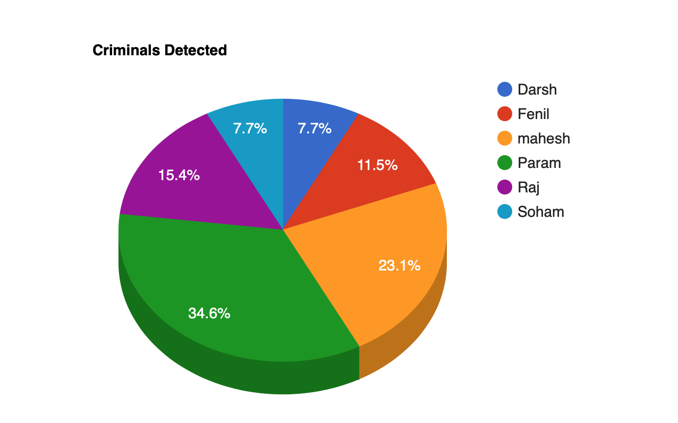
Various security features have been taken care of while designing CamRadar portal. By using extensive JavaScript codes we have made our system bulletproof from brute forcing attacks and auto login patches.
User Friendly interface is provided for easy navigation on our webportal. Plus there are easy to follow documentation for system usage instructions.
Features
Limitations
Database
Future Scope
Libraries Used
Haarcascade
System Function
Introduction
Conclusion
Application
Problem Definition

Slide 16
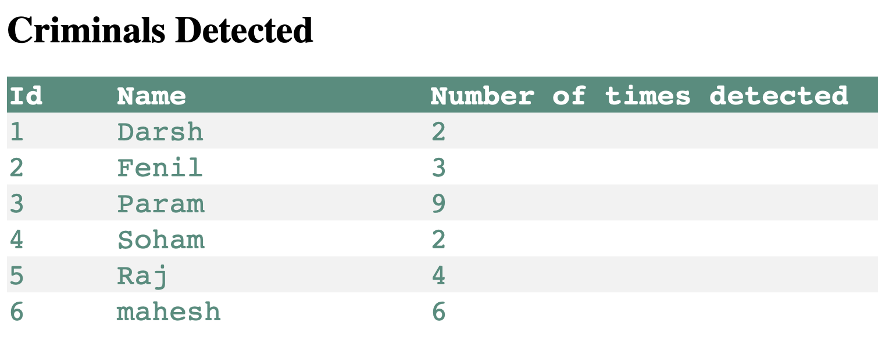
Limitations
Database
Future Scope
Libraries Used
Haarcascade
Features
System Function
Introduction
Conclusion
Application
Problem Definition

Slide 17
Various security features have been taken care of while designing CamRadar portal. By using extensive JavaScript codes we have made our system bulletproof from brute forcing attacks and auto login patches.
User Friendly interface is provided for easy navigation on our webportal. Plus there are easy to follow documentation for system usage instructions.
Features
Limitations
Database
Future Scope
Libraries Used
Haarcascade
System Function
Introduction
Conclusion
Application
Problem Definition

Slide 18
In this project, we are able to detect and recognize faces of the criminals in an image and in a video stream obtained from a camera in real time. We have used Haar feature-based cascade classifiers in OpenCV approach for face detection.
CamRadar team also learnt the importance of machine learning and how we can really make world a safer place to live in by using our college learnt engineering concepts.
Limitations
Database
Features
Future Scope
Libraries Used
Haarcascade
System Function
Introduction
Conclusion
Application
Problem Definition

